Slide 1
Probability and Statistical Inference
Getting Started with Predictive Statistics
Introducing Regression

Slide 2

Predictive Models
Used to explore the relationship between one outcome variable and a set of independent variables (predictors)
You should have a sound theoretical or conceptual reason for exploring the relationship and the order of the variables entering the model
For variables that have not been previously shown to contribute to the variation in the outcome variable try to establish statistical evidence for their inclusion in advance

Slide 3
Linear Regression
Sources used in creation of this lecture:
Statistics and Data Analysis, Peck, Olsen and Devore; Discovering Statistics Using R, Field, Miles and Field; Understanding Basic Statistics, Brase and Brase;SPSS Survival Manual, Julie Pallant

Slide 4
Predictive model – what does it allow you do?
Prediction
Really what we are looking at is the variance in the outcome variable and how much of the variance could be considered to be explained by the predictor variables
Questions it allows you to answer:
How well a set of variables is able to predict an outcome variable
Which variable in a set is the best predictor
Whether a variable is still able to predict an outcome when controlling for other variables

Slide 5
What is Linear Regression?
It is a hypothetical model of the relationship between two variables.
The model used is a linear one.
Theoretical assumption
For every one unit of change in the independent variable (predictor) there will be a consistent and uniform change in the dependent variable (predicted/outcome)
Therefore, we describe the relationship using the equation of a straight line.
This can be seen as a way of predicting the value of one variable from another.

Slide 6
Before Regression
We need to establish evidence to support going ahead with building a predictive model
If we are asserting a relationship
We need to investigate if there is any evidence of a relationship using correlation and make a decision based on the results (strength, direction etc.)
If we are asserting a differential effect for different groups
We need to investigate if there is any difference using either the appropriate test and make a decision based on the result

Slide 7
Simple Example – Linear Regression
Suppose we want to look at what variables predict a child’s maths score aged 16 in the UK ( GCSE)
We have a theory that their achievement on a standard maths test at aged 7 is a good predictor

Slide 8
Simple Example
y = a + bx + e
For a simple one predictor model.
‘y’ is the response variable to be predicted (in this case GCSE Score) – the dependent variable
This is a simple correlation.
y
x
Relationship between Maths score age 7 with GCSE result at age 16 (for 25 students)

Slide 9
Simple Example
y = a + bx + e
‘x’ is the predictor variable (in this case Maths Score aged 7) – independent variable
y
x
Relationship between Maths score age 7 with GCSE result at age 16

Slide 10
Simple Example
y = a + bx + e
‘a’ is the intercept or the point where the line crosses the y-axis;
y
x
Relationship between Maths score age 7 with GCSE result at age 16

Slide 11
Simple Example
y = a + bx + e
‘b’ is the gradient of the line
Represents the amount that the response variable changes for one unit change in the predictor variable
(e.g. for every one percentage point increase in a child’s Maths Test score, the line suggests that the child’s predicted GCSE Score will increase by ‘b’ points);
y
x
Relationship between Maths score age 7 with GCSE result at age 16

Slide 12
Simple Example
y = a + bx + e
‘e’ is an error term reflecting the fact that the line of best fit does not perfectly model the data.
Each child will have her/his own value for ‘e’ –called the residual – which is simply calculated by subtracting the child’s actual GCSE Score from the score predicted for them from the model.
y
x
Relationship between Maths score age 7 with GCSE result at age 16

Slide 13
Simple Example
y = a + bx + e
If the line did completely model the data then all of the points would rest exactly on the line.
Because there is a difference between what the line predicts (expected values) each student will achieve in their GCSE Score and what they actually achieved (observed values).
This difference is basically the vertical distance between each point and the line itself and this distance is ‘e’ .
y
b0
x
Relationship between Maths score age 7 with GCSE result at age 16

Slide 14
Simple Example
y = a + bx + e
‘e’ obviously varies for each young person.
Without any further information (i.e. additional predictor variables) we cannot model this additional variation and so just treat it as random error.
y
b0
x
Relationship between Maths score age 7 with GCSE result at age 16

Slide 15
Residuals

Slide 16
Using our model
We can re-write the overall model as an equation:
GCSE Score = a + (b x Maths Score) + error
To use the model to predict a child’s future GCSE Score we would tend to drop the ‘e’ term and thus use the formula:
Predicted GCSE Score = a + (b x Maths Score)
We are now referring to the response variable as the ‘Predicted GCSE Score’ rather than the actual GCSE Score.

Slide 17
Using our model
Suppose we have plugged our numbers into our statistical tool and it has given us the following values:
a = 15 ; b = 0.7
Our model becomes:
Predicted GCSE Score = 15 + 0.7 x Maths Score
Based on our data this represents our best estimate of what a child’s future GCSE Score is going to be, on average, given their Maths Score at age 7.
It is not going to be 100% correct as we know there is an error term

Slide 18
Using our model
So suppose a child got just 10% in their maths test aged 7.
Predicted GCSE Score = 15 + 0.7 x 10 (maths test aged 7)
= 15 + 7 = 22.0
A child who gets 60% in their maths test aged 7:
Predicted GCSE Score = 15 + 0.7 x 60
= 15 + 42= 57
Looking at a student who gets 61% we can see what the gradient b is doing in practice:
Predicted GCSE Score = 15 + 0.7 x 61
= 15 + 42.7= 57.7
From our model we can see that on average one unit increase in Maths score aged 7 is predicted to lead to a 0.7 increase in GCSE Maths score aged 16.

Slide 19
Using our model
The gradient therefore represents the average increase in the response variable (GCSE Score) with one unit increase in the predictor variable (Maths Score).

Slide 20
Sample Dataset (Regression.sav)
The dataset comprises a sample of 4,059 young people (aged 16) selected from 65 difference secondary schools from six inner London Education Authorities.
This is a sub-sample from a much larger study undertaken by Goldstein, H., Rasbash, J., Yang, M., Woodhouse, G., et al. (1993) A multilevel analysis of school examination results, Oxford Review of Education, 19, pp. 425-433.
The dataset has been specifically prepared to accompany Rasbash, J. et al. (2005) A User’s Guide to MLwiN 2.0 (Bristol, Centre for Multilevel Modelling).

Slide 21
Simple Linear Regression

Slide 22
Simple Linear Regression
The theory we are exploring is whether the main predictor of ‘normexam’ is a student’s prior performance in a reading test at age 11 (the variable ‘standlrt’)
The response (outcome or dependent) variable in this case is the student’s exam score at age 16 (‘normexam’) that has been converted into a standardised score (with mean = 0 and standard deviation = 1).
The predictor (independent) variable in this case is the students prior performance in a reading test at age 11 (standlrt) which is also a standardised score)

Slide 23
Simple Linear Regression
It is generally good practice to standardise your response and predictor variables before including them in the model
It helps in the interpretation of the model.
For example, if all the predictor variables have been standardised then we know that if they all have the value ‘0’ this would represent the average student.
As such, the constant in the model comes to represent the mean score on the response variable for the average student in the sample.
If the response variable has been standardised we can immediately gain a sense of where the ‘average student’ fits in the distribution of the response variable
(i.e. if the constant is negative then we know that they have a mean score below the mean for the sample as a whole, and so on).

Slide 24
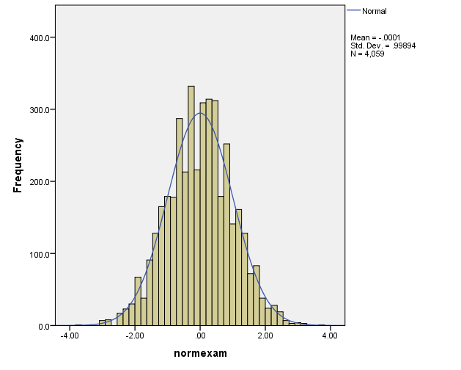

Simple Linear Regression
Start by looking at the variable :
Create a histogram
Create some descriptive statistics
The response variable (normexam) is approximately normally distributed and approximately standardised (with mean = -0.0001 and standard deviation = 0.9989).

Slide 25
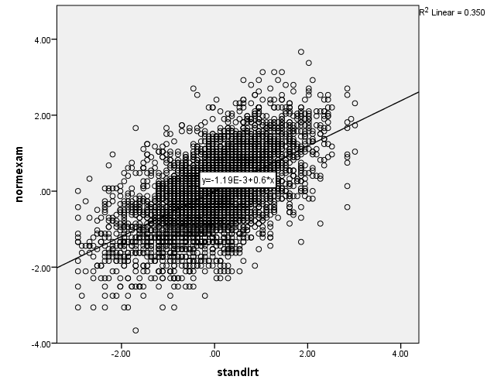
Simple Linear Regression
Before we create a linear regression model it is worth exploring the nature of the relationship between the response variable and this predictor variable.
Look at the scatterplot
Calculate the correlation for these two variables
There appears to be a strong linear relationship. – R² = 0.35, r=0.592.

Slide 26
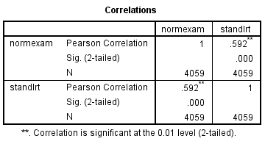
Simple Linear Regression
Increase scores in standlrt appear to associated with increase scores in normexam.
There appears to be a moderately strong correlation between the two (r = 0.592, p<0.001).
Therefore there is good justification for using regression to look at prediction.
Note: we say moderately strong as Cohen says 0.5 is strong so we are qualifying out result.

Slide 27
Simple Linear Regression
To formally model this relationship now we can create a simple linear regression model (assuming we have read our data file into a dataframe called regression):
model1<-lm(regression$normexam~regression$standlrt)
We now have access to all the elements of the regression output in the variable model which we can unpack and examine.

Slide 28
How Good is the Model?
The regression line is only a model based on the data.
This model might not reflect reality.
We need some way of testing how well the model fits the observed data.
How has the model helped improve our understanding in the absence of any model?

Slide 29
How Good is the Model?
What would we use in the absence of the model?
The common approach would be to use the mean of the sample
This would be wrong in the vast majority of the cases – depending on the variation in the sample
i.e. how much each case varies from the mean
But we can use it as a baseline to see if our model has improved our understanding

Slide 30
How good is the model?
So how do we go about it?
We square the differences from each data point to our mean for our outcome variable
Squaring these gives us the total sum of squares = all variation that exists
But we will still experience some error
This is the variation between our observed data and our regression line
Squaring these errors gives use the residual sum of squares (unexplained sum of squares) = variation which is left over after the model is fitted to the data
Difference between the two is the amount of variation accounted for by the model

Slide 31
Sums of Squares
SS_{T}
Total variability (variability between scores and the mean).
SS_{R}
Residual/Error variability (variability between the regression model and the actual data).
SS_{M}
Model variability (difference in variability between the model and the mean).

Slide 32
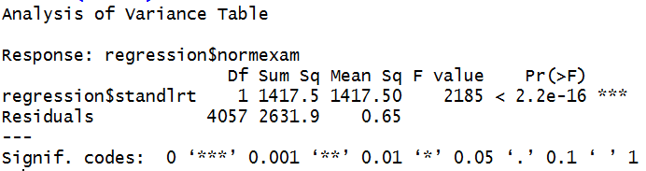
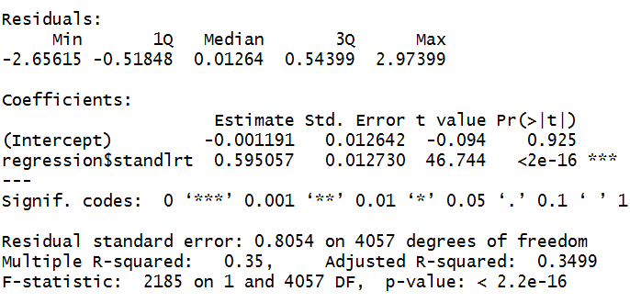
Simple Linear Regression
The F statistic looks at whether the model as whole is statistically significant
This allows us to answer the question:
Do the independent variables, taken together, predict the dependent variable better than just predicting the mean for everything?
To get this information in R:
anova(model1)
summary(model1)

Slide 33
Simple Linear Regression
SS_{M}
SS_{R}
SS_{R}
Residual/Error variability (variability between the regression model and the actual data).
SS_{M}
Model variability (difference in variability between the model and the mean).
SS_{T}
Total variability (variability between scores and the mean).

Slide 34
Sums of Squares
SS_{T}
Total variability (variability between scores and the mean).
SS_{R}
Residual/Error variability (variability between the regression model and the actual data).
SS_{M}
Model variability (difference in variability between the model and the mean).

Slide 35
Testing the Model: ANOVA
Mean Squared Error
Sums of Squares are total values.
They can be expressed as averages.
These are called Mean Squares, MS

Slide 36
Simple Linear Regression
MS_{M}
MS_{R}
MS_{M}
Mean Square Error of the Model
MS_{R}
Mean Square Error of the Residuals

Slide 37
Testing the Model: R²
R²
The proportion of variance accounted for by the regression model.
The Pearson Correlation Coefficient Squared

Slide 38
Simple Linear Regression
anova(model)
In this case there is only one independent variable, standrlrt.
The F-test is testing if this one variable predicts the exam scores at age 16 (normexam) better than if we used the average score of normexam to predict values for all students.
It seems it does as it is statistically significant p < 0.001.
But how useful is it?

Slide 39
Simple Linear Regression
The R² is the proportion of variance in the outcome (dependent) variable normexam which can be explained by the predictor (independent) variables. This is the usefulness of the model.
An R² of 1 means the independent variable explains 100% of the variance in the dependent variable. Conversely 0 means it explains none.
In this case we have a value of 0.350 which means that standlrt explains 35% of the variance in normexam.
The remaining variance can be explained by variables not currently included in the model.

Slide 40
Simple Linear Regression
We have only one predictor at the moment so R² and adjusted R² are the same.
When we include more predictors it is the adjusted R² we will use.

Slide 41
Simple Linear Regression
The final thing to look at is ‘Coefficients’ gives us all the information we need to construct the actual model using unstandardized co-efficients.
The significance levels for each of the main terms (in this case the coefficients associated with the constant and ‘standlrt’) also tell us if there is evidence that each of these terms are adding something to the model (they are statistically significant).
Using the Coefficients from this table we get the following model:
Predicted ‘normexam’ = -0.001 + 0.595 x ‘standlrt’
Note: The intercept is the constant

Slide 42
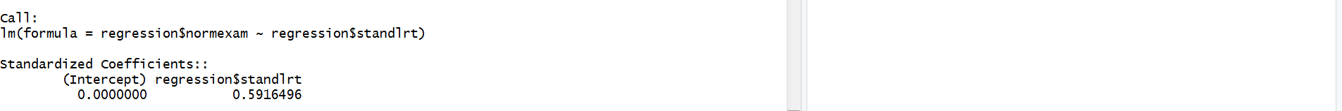
Simple Linear Regression
Call: lm(formula = regression$normexam ~ regression$standlrt) Standardized
Coefficients::
(Intercept) regression$standlrt
0.0000000 0.5916496
Standardised Coefficients
Not hugely useful for our model since the variable are all standardized.
Function: lm.beta(model1)

Slide 43
What is Multiple Regression?
Simple linear Regression is a model to predict the value of one variable from another.
Multiple Regression is a natural extension of this model:
We use it to predict values of an outcome from several predictors.
It is a hypothetical model of the relationship between several variables.

Slide 44
Multiple Regression as an Equation
With multiple regression the relationship is described using a variation of the equation of a straight line.
b0 is the intercept.
The intercept is the value of the Y variable when all Xs = 0.
This is the point at which the regression plane crosses the Y-axis (vertical).
b₁ to b_{n} are the regression coefficient for variable 1 to n
Notes:
A similar equation can be derived in which each predictor variable has its own coefficient, and the outcome variable is predicted from a combination of all the variables multiplied by their respective coefficients plus a residual term (see equation above).
Y is the outcome variable, β₁ is the coefficient of the first predictor (X₁), β₂ is the coefficient of the second predictor (X₂), β_{n} is the coefficient of the n^{th} predictor (X_{n}), and ε_{i} is the difference between the predicted and the observed value of Y for the i^{th} subject. In this case, the model fitted is more complicated, but the basic principle is the same as simple regression. That is, we seek to find the linear combination of predictors that correlate maximally with the outcome variable.

Slide 45
Dummy variables
Many variables we are interested in prediction are categorical
E.g. we are interested in the effect gender or religion or income category has
Because they have no scale it makes no sense to think of the effect of a unit of increase in these as it would for a continuous variable
But we can think in terms of the differential effect for groupings within the category
We can transform the categorical variable into a series of dummy variables which indicate whether a particular case has that particular characteristic
Dummy variables may also be referred to as indicator variables

Slide 46
Our regression dataset (Regression.sav)
Previously looked at standlrt as a predictor of normexam
We might also be interested in gender and whether it has an influence
There is significant research that gender has an influence in educational achievement.
We might also be interested in exploring the type of school a student attends (either mixed-sex or single-sex boys or girls schools) as this might also have an effect on a student’s examination performance (‘normexam’).
We are interested in exploring if there is a differential effect for students of different genders and for students of different genders attending different types of school.

Slide 47
Dummy Variables
If we just added them into the model as they are what would happen?
The values of these two variables would be treated as real numerical values rather than just arbitrary numbers representing specific categories.
So we need to transform these into dummy variables before we can add them into the regression model.

Slide 48
Dummy variables
Recode to 0 (reference category) and 1 (category of interest)
Aim is to explore if there is a differential effect for the category of interest when compared to the reference category
Indicator variable
Switch effect ON (1) or OFF (0)
Before including in the regression model need to first establish if this makes sense to include as a predictor
Investigate using an independent t-test.

Slide 49
Recoding Variables
library(car)
regression$gender=recode(regression$GIRL,'0=1;1=2')
(this creates a variable gender which recodes GIRL, if 0 gender is set to 1 and if 1 gender is set to 2)
This assumes that you have called your dataset regression and there is a variable gender (there isn’t in our data, it is already coded for us in a variable Girl)
This is already done in the dataset you have been given

Slide 50
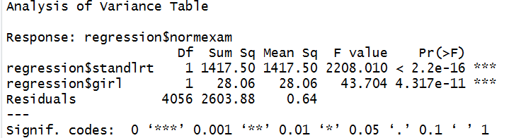
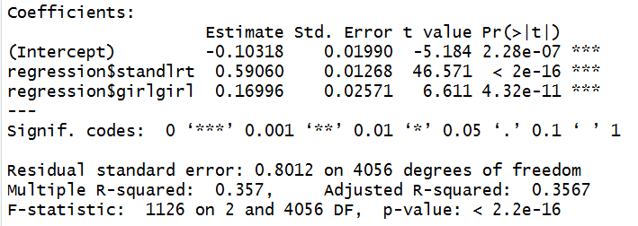
Adding Girl to the model
model2<-lm(regression$normexam~regression$standlrt+girl)
anova(model2)
summary(model2)
Our model is still significant

Slide 51
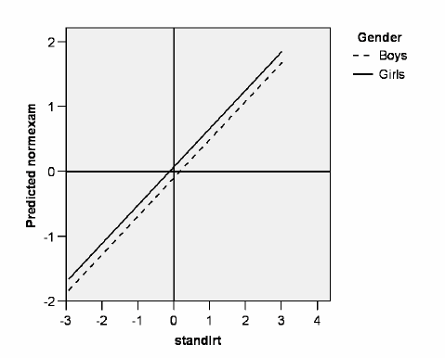
Example
In effect the consequence of adding the dummy variable ‘girl’ to the model is to create two lines of best fit that have the same gradient (0.590) but different intercepts (constants) (i.e. -0.103 for boys (the constant term) and 0.066 for girls (the constant + the co-efficient for girl).
In other words, and as illustrated here, this model can be represented as two parallel lines with the vertical distance between both lines being 0.170 for the average student (value of 0 for standlrt) when you calculate the equation for boys and girls.
Boys normexam = -.103+.590=0.487
Girls normexam=-.103+.590+.167=0.654

Slide 52
Multiple Linear Regression
Our regression equation
Normexam=-0.10+0.59*standlrt+0.17*girl

Slide 53
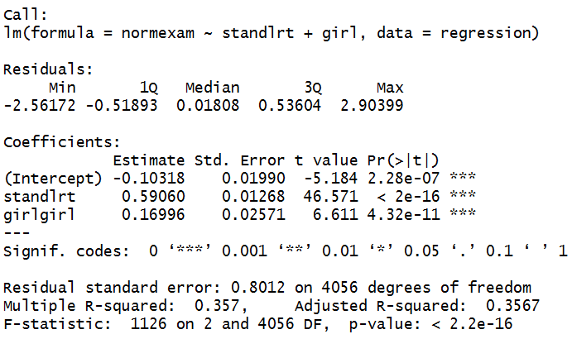
Multiple Linear Regression
To investigate the impact gender is having we include our recoded variable into the model:
Notice the slight changes in the coefficient for standlrt from the first model

Slide 54
How good a fit is this second model?
In this case our Adjusted R2 (from the summary) Adjusted R-squared: 0.3567
So this model explains 35.67% of the variance in comparison to 35% for model1

Slide 55
Multiple Linear Regression
Our regression equation:
Normexam=-0.10+0.59*standlrt+0.17*girl
Lets explore what this means
For a boy their score for normexam on average increases by 0.49 from their standlrt score:
Normexam=-0.10+0.59*standlrt+0 #since girl is 0 for boys
For a girl their score increases by 0.66 from their standlrt score:
Normexam=-0.10+0.59*standlrt+0.17
So being a girl is on average adding 0.17 to your score at age 16
So there is a positive differential effect

Slide 56
Linear Regression
Four important statistics
F statistic
Whether the model as a whole predicts the dependent variable
Its statistical significance is the significance of the model
Regression coefficients (Beta values)
Measure the strength and direction of relationships between independent variables and the dependent variance
Significance scores for the regression coefficients
Tell us whether the contribution of each variable is statistically significant
R² statistic or Adjusted R² Statistic
Measures the model’s overall predictive power and the extent to which the variables explain the variation found in the dependent variable

Slide 57
How to Interpret Beta Values
Beta values:
the change in the outcome associated with a unit change in the predictor.
Standardised beta values:
tell us the same but expressed as standard deviations.
If we have standardised our variables in advance this will be virtually the same.

Slide 58
R² V Adjusted R²
Every time you add a predictor to a model, the R-squared increases, even if due to chance alone. It never decreases.
Therefore, a model with more terms may appear to have a better fit simply because it has more terms.
If a model has too many predictors it begins to model the random noise in the data.
This condition is known as overfitting the model and it produces misleadingly high R-squared values and a lessened ability to make predictions.
Adjusted R²
Adjusts value of R² based on number of variables in the model
Report Adjusted R² for multiple linear regression

